Slide 1
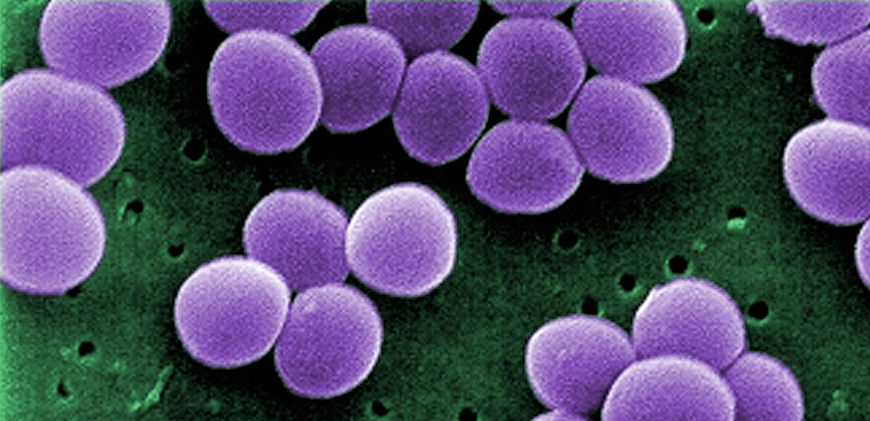
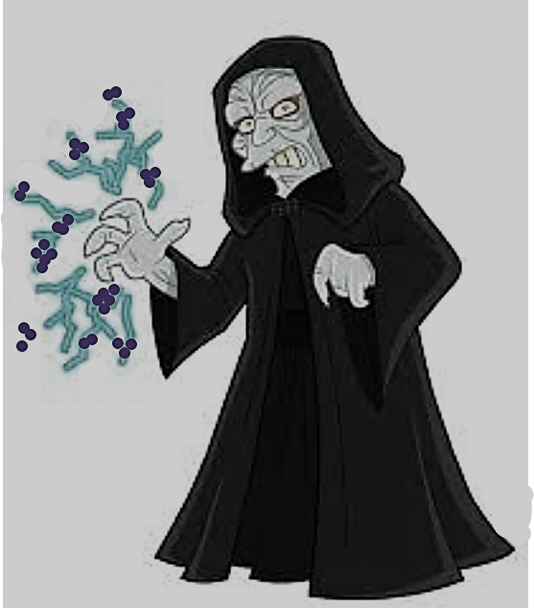
The Phantom MRSA: How to Use Jedi Mind Tricks and Other Tips to Kick Your Vancomycin Habit
Leila S. Hojat, MD
Director, UH Antimicrobial Stewardship Program

Slide 2
Objectives
Describe clinical aspects and treatment options for MRSA infections
Analyze current utilization of anti-MRSA agents
Discuss a rational approach to optimization of anti-MRSA treatment
Identify antimicrobial stewardship resources for anti-MRSA treatment

Slide 3

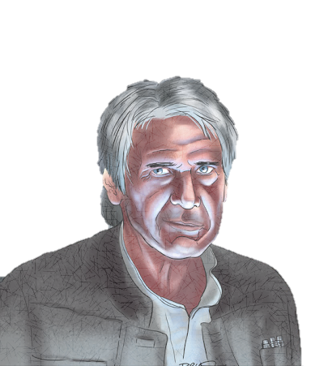
Case 1
Han is a 68-year-old male with history of HTN, IDDM (A1c 10.4), CKD stage 3, osteoarthritis, afib on anticoagulation
Presents with bilateral hip pain (R>L) last several days after a fall
In the ED was febrile with WBC count of 20.5
MRI findings:
7.5 x 2.4 cm fluid collection within the R iliacus
Pyomyositis with small abscesses of the L thigh/gluteal muscles
L hip septic arthritis
Ortho aspirated purulent fluid from right hip
Obtained blood cultures and started empirically on vancomycin and piperacillin-tazobactam
Blood cultures 12 hours later are positive

Slide 4
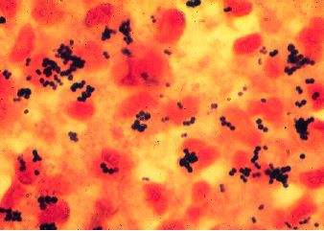
Gram stain from aspirate

Slide 5

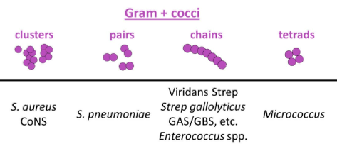
“where there is Staph, there is pus, and where there is pus, there is Staph” - MW, as told by KBA
Mildly immunocompromised
+
Community-onset
+
Pus everywhere
Staphylococcus aureus
+
S. lugdunensis
Everything else
Notes:
Unlike S. aureus, S. lugdunensis does not possess secreted coagulase. However, some isolates produce a membrane-bound form of the enzyme (clumping factor) that yields a positive result in slide coagulase and/or rapid latex agglutination tests, potentially leading to misidentification of the organism as S. aureus in the clinical laboratory.
Frank, Clin Microbiol Rev, 2008

Slide 6
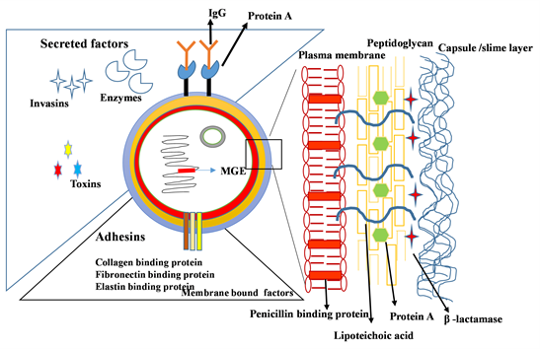
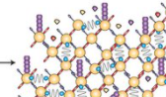
Staphylococcus aureus (SA)
biofilm
Commensal
Ubiquitous colonizers
May breach innate host defenses
Many virulence determinants
Infections often recurrent
hemolysins
leukocidins (PVL)
superantigens/
enterotoxins
clumping factor
Divyakolu Adv Infect Dis 2019

Slide 7
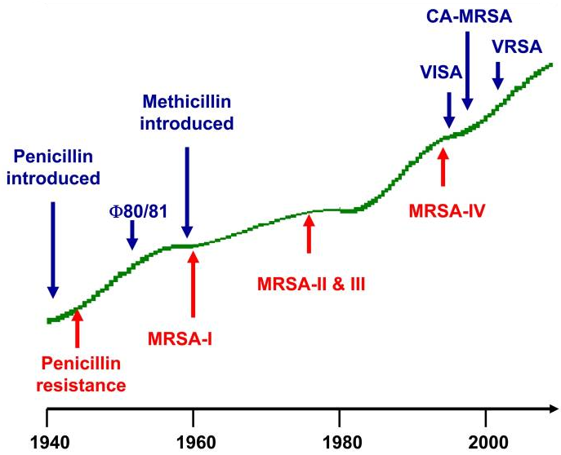
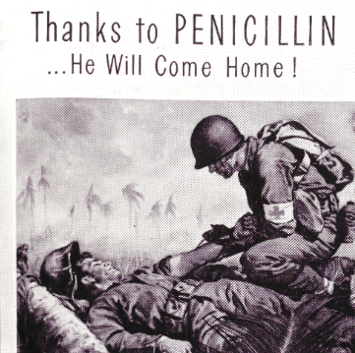
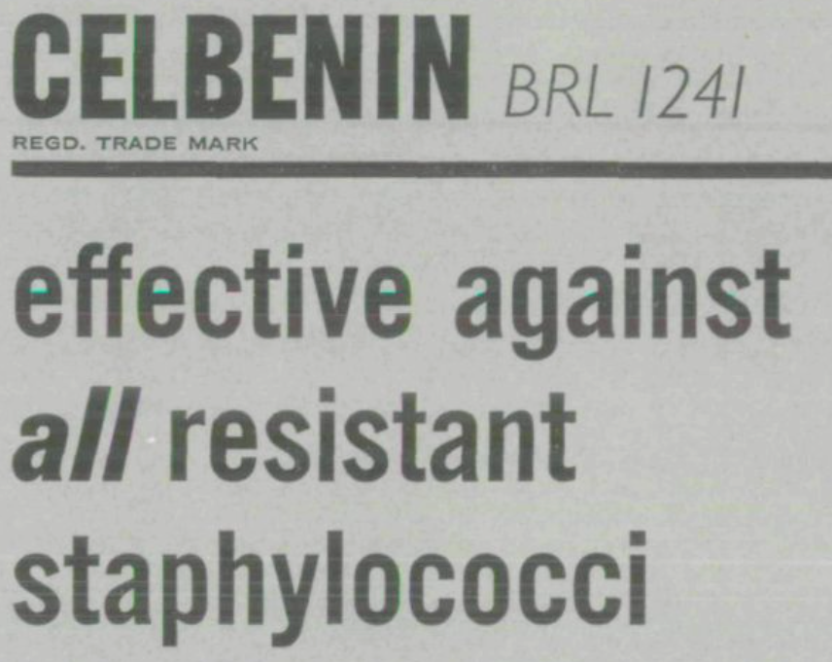
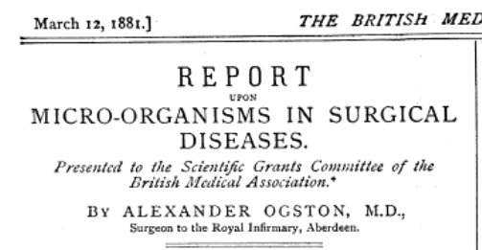
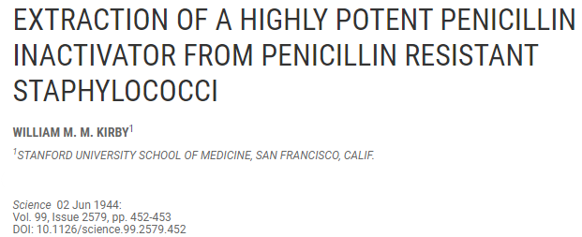
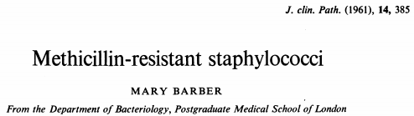
Progression of SA Resistance
Penicillin discovered
S. aureus identified
1880
1930
Chambers. Nat Rev Microbiol. 2009

Slide 8
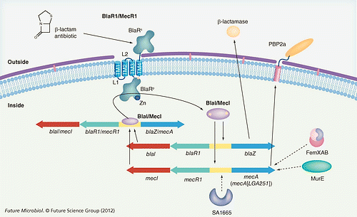
SA Resistance Mechanisms

Slide 9
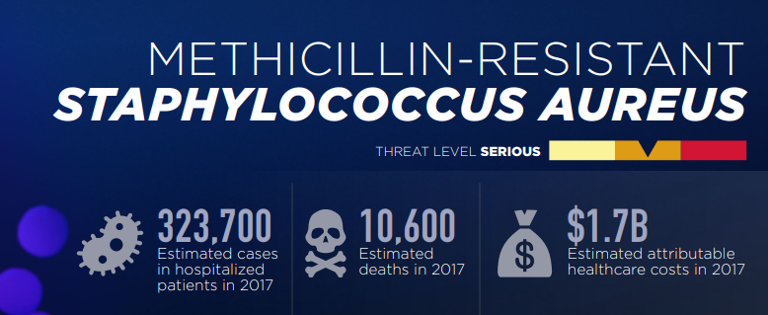
Methicillin-Resistant S. aureus (MRSA)
~50-60% of hospital associated SA
Higher length of stay, mortality, costs
Most frequent cause of community-associated (CA) SSTI
CA-MRSA often highly virulent – PVL
Notes:
Esp athletes, daycare, military, PWID, incarcerated, MSM

Slide 10
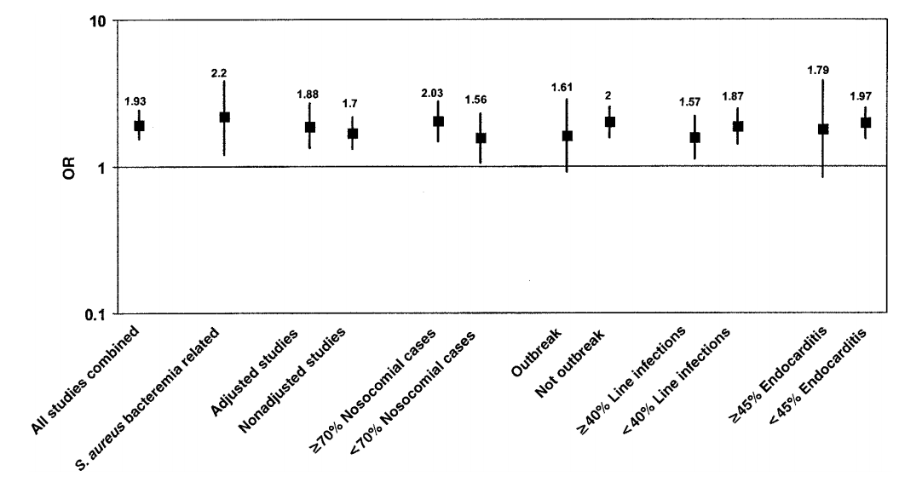
MRSA vs MSSA Mortality
Cosgrove Clin Infect Dis 2003

Slide 11
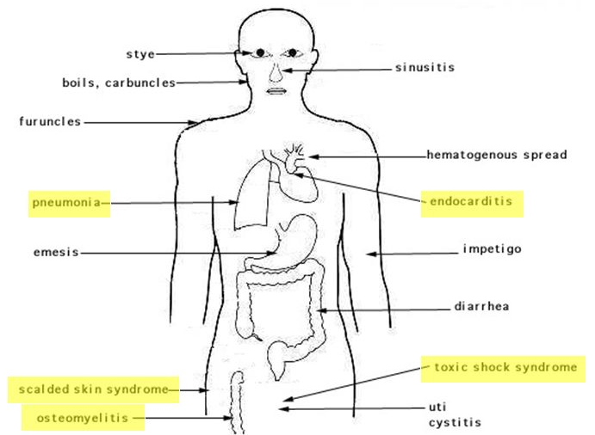
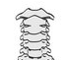

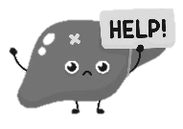
Common MRSA Disease Manifestations
meningitis/ epidural abscess
line infection
bacteremia
solid organ abscess
septic arthritis
JS Bennett, UKHealthCare

Slide 12
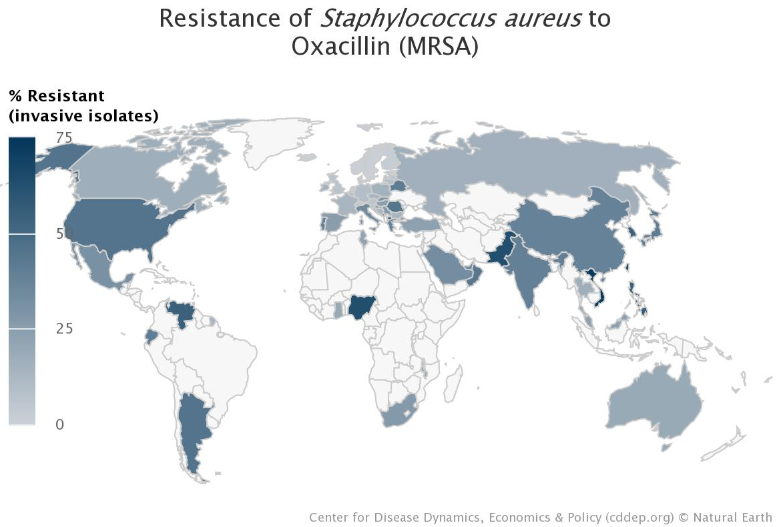
Global MRSA Prevalence

Slide 13
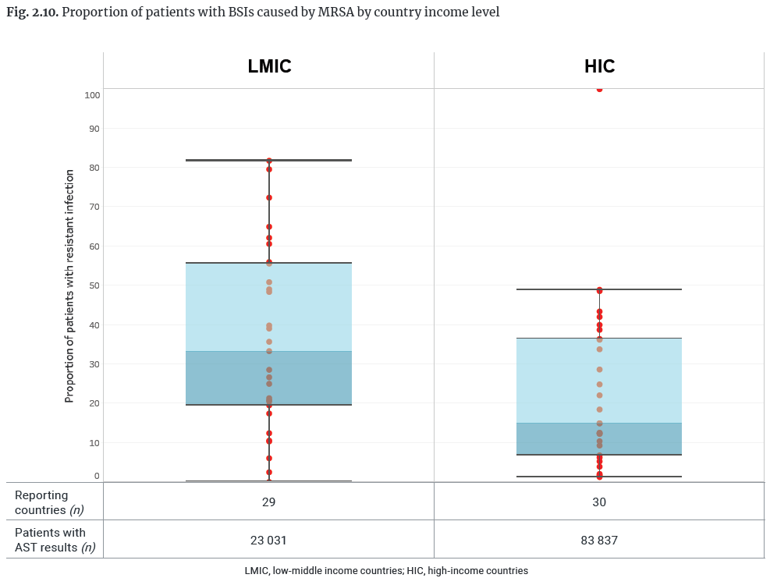
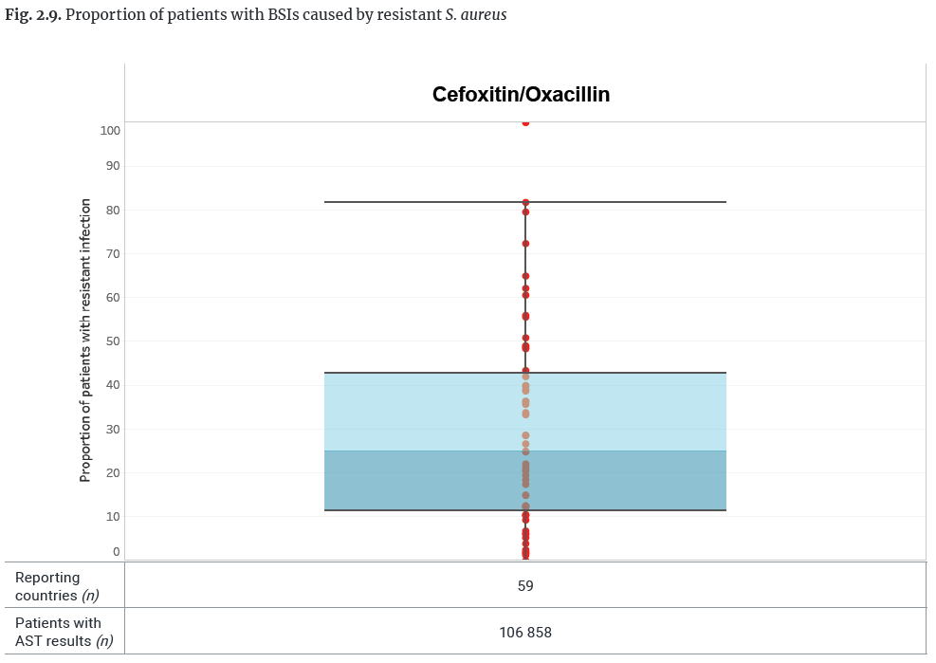
Global MRSA Bloodstream Infection Proportion
WHO GLASS Report 2021

Slide 14
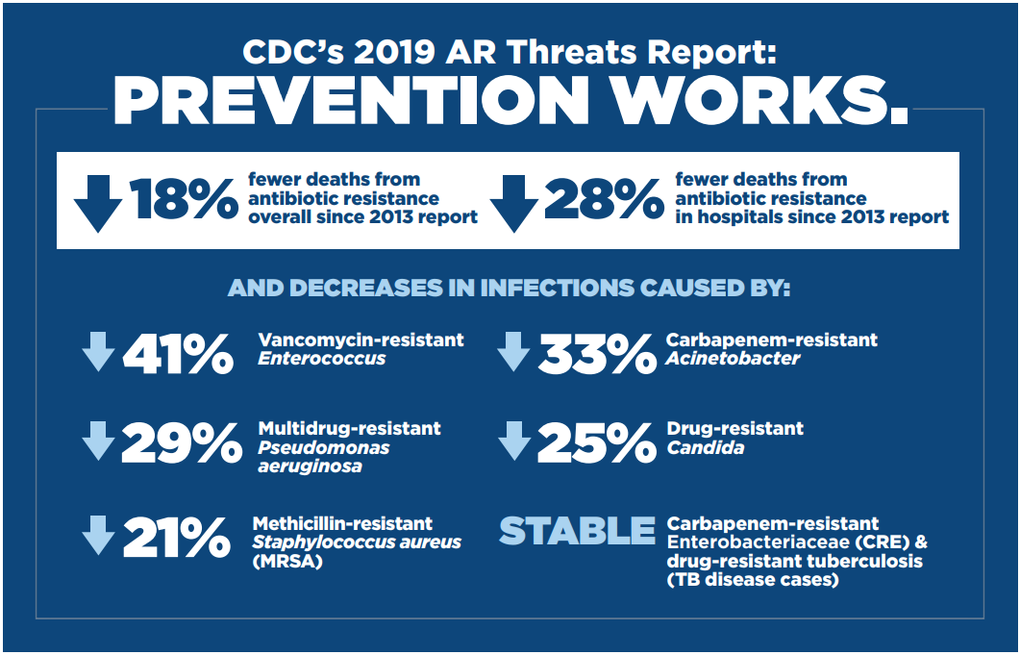
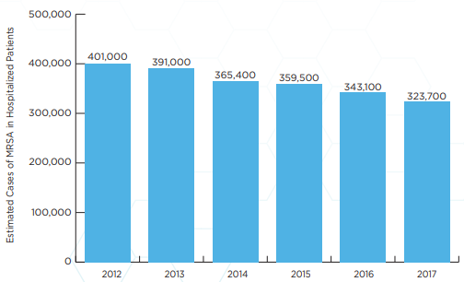
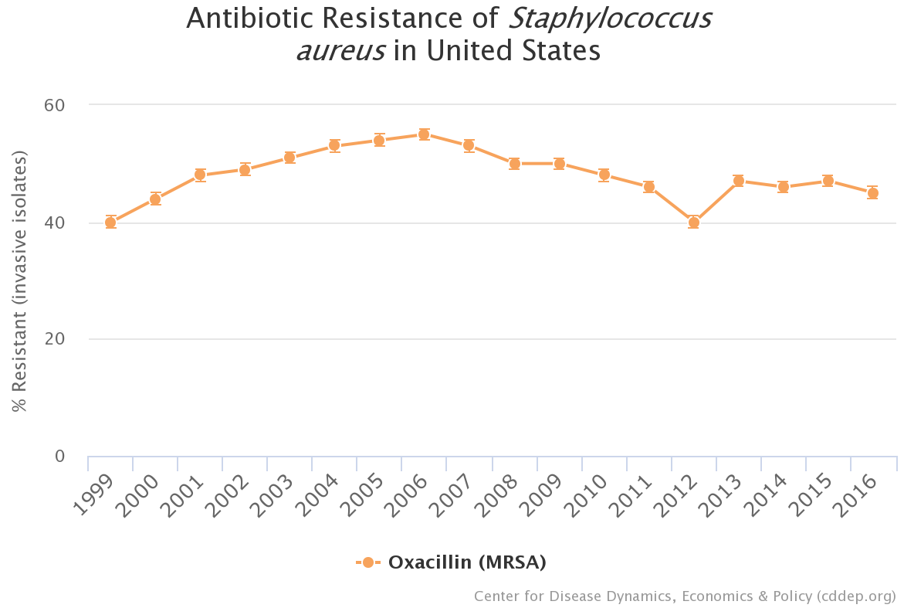
Decreasing Prevalence in US
Notes:
Data includes aggregated resistance rates for isolates (includes intermediate resistance) from blood and cerebrospinal fluid (i.e., invasive) from inpatients of all ages. Because of differences in scope of collections and testing methods, caution should be exercised in comparing across countries.

Slide 15
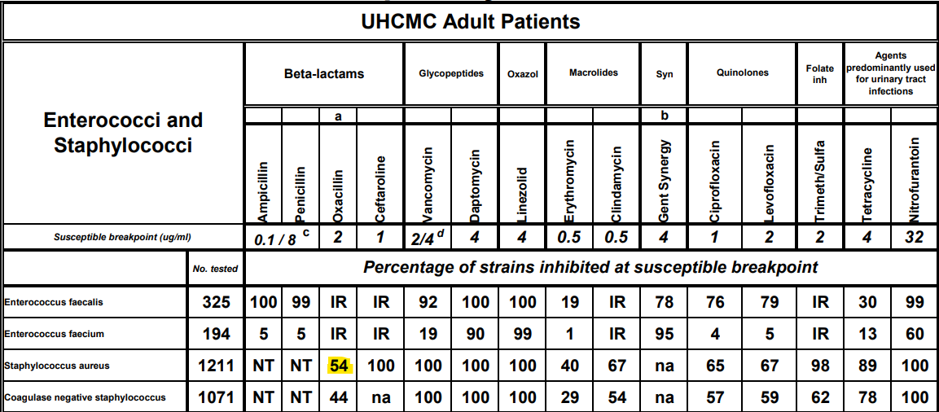
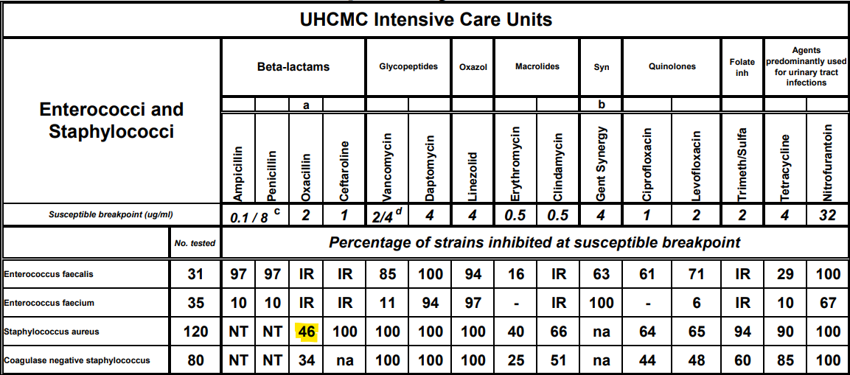
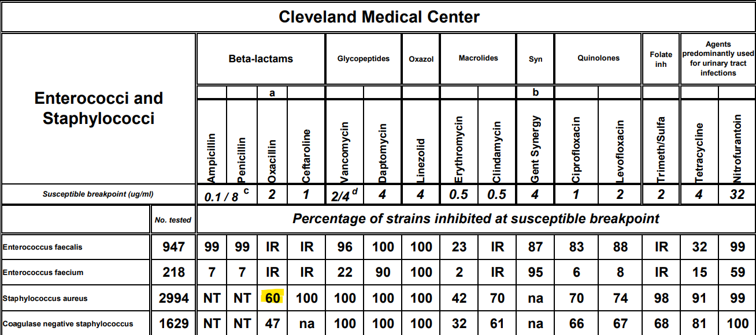
MRSA Prevalence at CMC Ranges from 40 to 54%

Slide 16
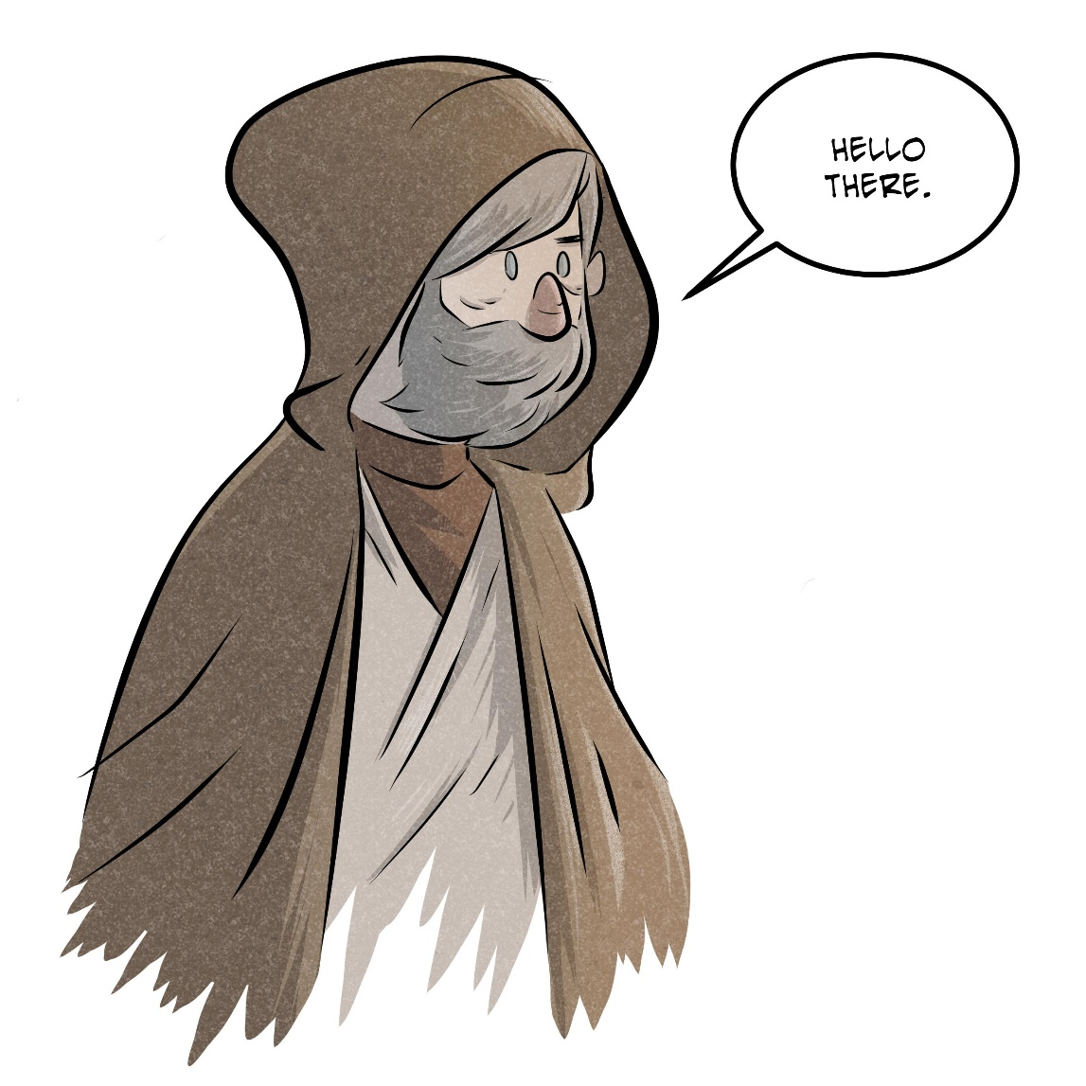

Case 2
Ben is a 92-year-old male with history of HTN who presents from his SNF with shortness of breath and AMS
Vitals: HR 104, BP 112/74, RR 32, afebrile, SpO2 87% on RA
Imaging shows multilobar infiltrates
Hypoxia improved on 4L O2 via NC
Sent blood cultures, started vancomycin, piperacillin-tazobactam, and azithromycin, admitted to MICU for close monitoring

Slide 17
Anti-MRSA Agents
Intravenous Agents
Oral Agents
Vancomycin
Daptomycin
Ceftaroline
Tigecycline, Eravacycline
Dalbavancin, Oritavancin
Doxycycline
Trimethoprim-Sulfamethoxazole
Linezolid
Clindamycin
Fluoroquinolones
Rifampin

Slide 18
Anti-MRSA Agents
Intravenous Agents
Oral Agents
Vancomycin
Daptomycin
Ceftaroline
Tigecycline, Eravacycline
Dalbavancin, Oritavancin
Doxycycline
Trimethoprim-Sulfamethoxazole
Linezolid
Clindamycin
Fluoroquinolones
Rifampin

Slide 19
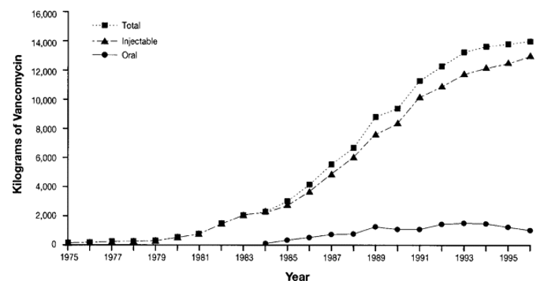
“Vanquish”
Vancomycin identified by Eli Lilly in 1952
Amycolatopsis (Streptomyces) orientalis in Borneo dirt
Levine Clin Infect Dis 2006
Notes:
Use of vancomycin in the United States, France, Italy, Germany, the United Kingdom, and The Netherlands. Reprinted from Kirst et al. [28] with permission from the American Society for Microbiology.

Slide 20
Indications for Vancomycin Orders at CMC

Slide 21


CMC Vancomycin Use by Unit and Month
Is that a lot?

Slide 22
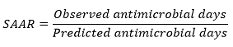


Standardized Antimicrobial Administration Ratio
SAAR < 1.0 – antimicrobial use less than predicted
SAAR = 1.0 – antimicrobial use equivalent to predicted
SAAR > 1.0 – antimicrobial use greater than predicted

Slide 23
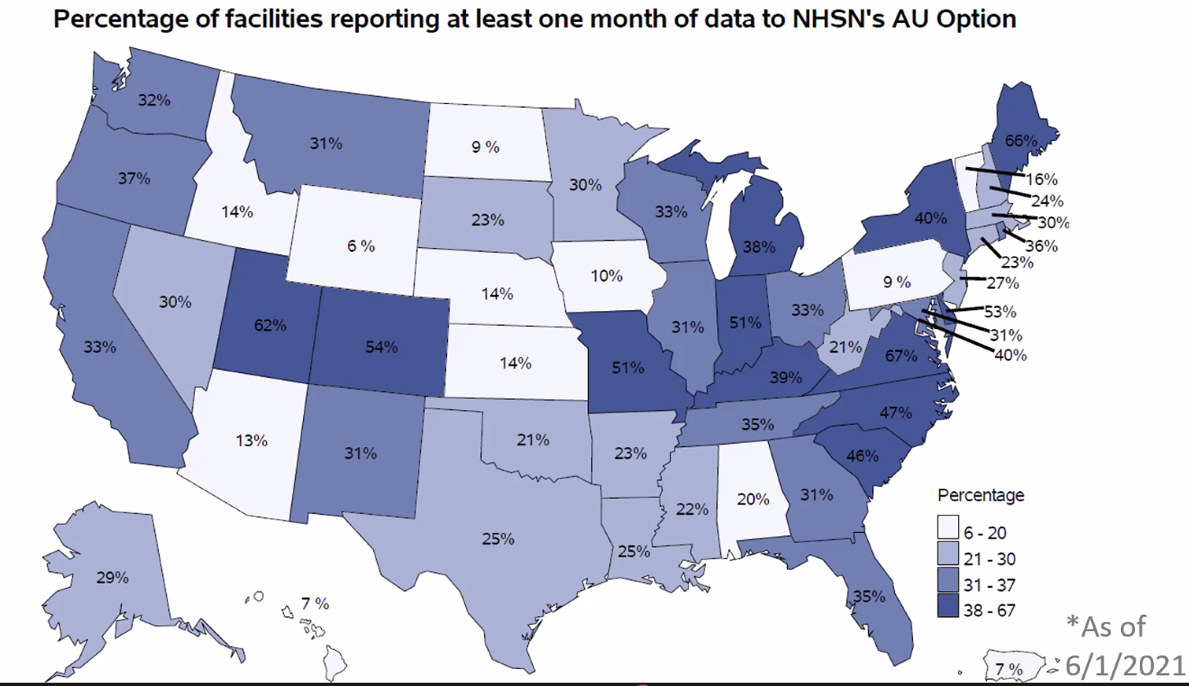


Slide 25
We Use a Lot of Vancomycin
Disproportionally high volume of anti-MRSA treatment
Relative to hospitals similar to CMC, and
Relative to actual amount of MRSA recovered at CMC
Costs
Adverse events
Excess blood draws
Pharmacy time
Increased resistance

Slide 26

Case 3
Leia is a 66-year-old female with IDDM, PVD, CAD s/p PCI x3, smoking (40 pk/yrs), and multiple DFIs s/p right BKA and left foot TMA
Presents with purulent drainage from BKA stump
Patient taken to OR for debridement, noted to have evidence of unhealthy bone
Started on vancomycin and piperacillin-tazobactam empirically
Cultures grew E. faecium, susceptibilities pending

Slide 27
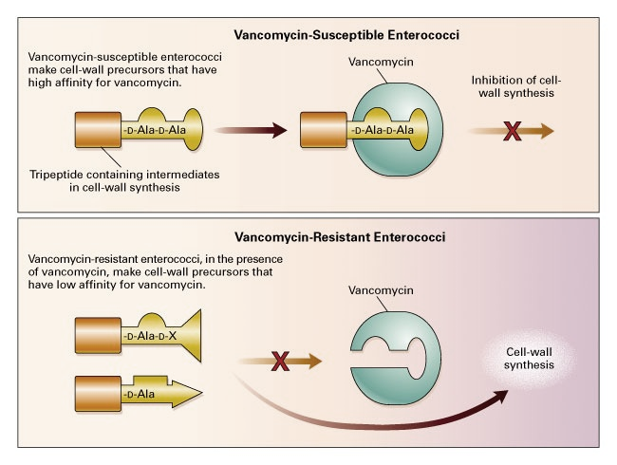
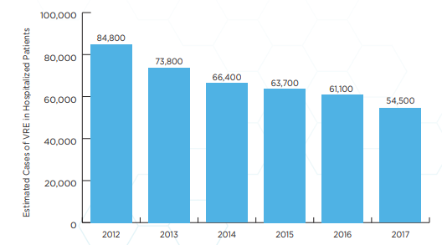
Vancomycin-Resistant Enterococcus (VRE)
Murray NEJM 2000
Represents ~30% of healthcare-associated enterococcal infections
Notes:
The genes for the VanA vancomycin resistance phenotype confer high-level resistance to vancomycin and teicoplanin (6, 7), as well as variable levels of resistance to all other glycopeptides (18). The VanB resistance phenotype confers variable levels of resistance to vancomycin but leaves the organism susceptible to teicoplanin (8, 13). VanD is characterized by resistance to moderate levels of vancomycin and to low levels of teicoplanin (21), while the VanE resistance phenotype exhibits low-level resistance to vancomycin but full susceptibility to teicoplanin (15).
Enterococci of the VanA, VanB, and VanD phenotypes produce a suite of functionally homologous proteins, including ligases (VanA, VanB, and VanD) resulting in the formation of peptidoglycan precursors terminating in d-Ala-d-Lac (18, 21), dehydrogenases (VanH, VanH_{B}, and VanH_{D}) which reduce pyruvate to d-lactate (7, 10, 11), dipeptidases (VanX, VanX_{B}, and VanX_{D}) which hydrolyze the glycopeptide-susceptible cell wall precursors ending in d-Ala-d-Ala (7, 11, 24), and carboxypeptidases (VanY, VanY_{B}, and VanY_{D}) (5, 11, 14) which cleave the C-terminal d-Ala residue of late peptidoglycan precursors (22). VanE ligase synthesizes the formation of peptides terminating in d-Ala-d-Ser, and serine racemase activity has also been detected in VanE strains (15).
McKessar Antimicrob Agents Chemother 2000

Slide 28
CMC E. faecium Vancomycin Susceptibility Rate by Year

Slide 29

VRE Treatment
Daptomycin
Linezolid
Tigecycline/Eravacycline
Quinupristin-Dalfopristin (E. faecium only)
Telavancin
Oritavancin

Slide 30
VRE Treatment
Daptomycin
Linezolid
Tigecycline/Eravacycline
Quinupristin-Dalfopristin (E. faecium only)
Telavancin
Oritavancin

Slide 31
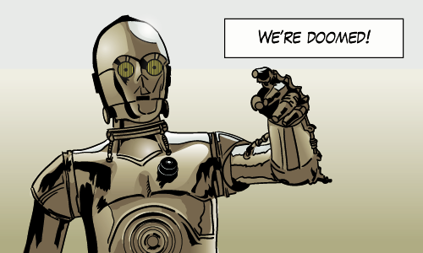
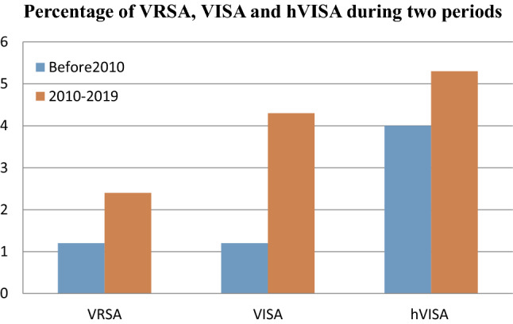
Vancomycin Resistance
Susceptible ≤ 2 μg/mL
Intermediate resistance = 4 to 8 μg/mL
Resistant ≥ 16 μg/mL
Heteroresistance may be associated with treatment failure
Global Rates of Resistance
Shariati Sci Rep 2020

Slide 32
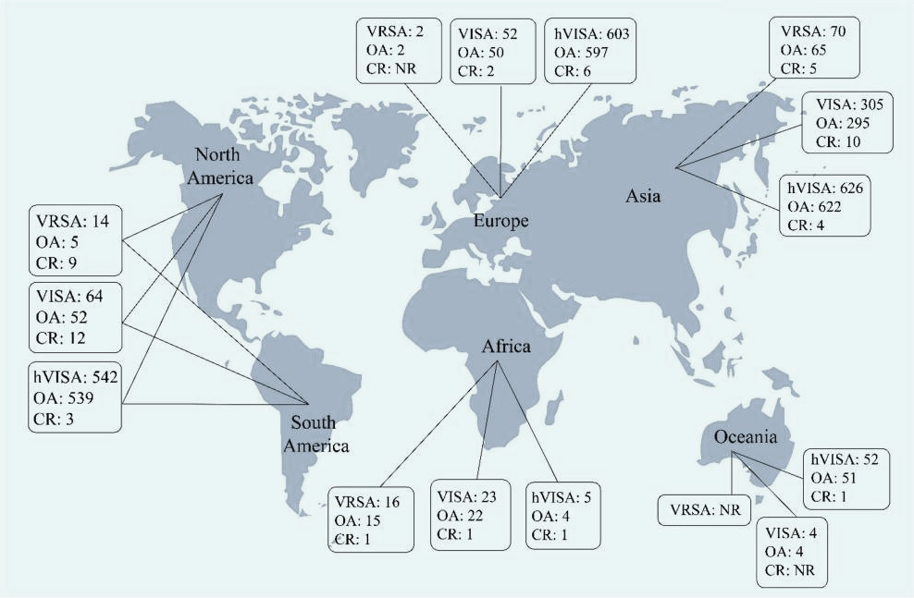
Shariati Sci Rep 2020

Slide 33
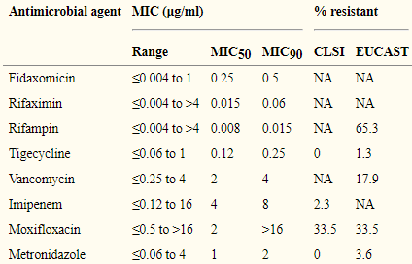
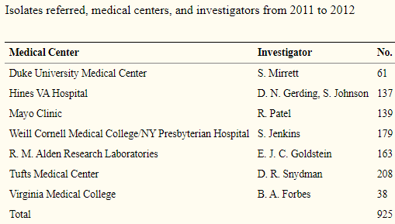
C. difficile Resistance
Gradually increasing MIC
Not clearly associated with clinical failure – high intraluminal concentration
Snydman Antimicrob Agents Chemother 2015

Slide 34

Case 4
Sheev is a 119-year-old male with unknown past medical history presenting with AMS
Exam – mildly tachycardic, A&Ox0, poor skin turgor
WBC 11.9, Cr 1.8, other baseline labs wnl
UA – 28 WBCs, 4 RBCs, +LE, 1+bacteria, 1+protein
CXR – few scattered opacities, cannot rule out pneumonia
Blood and urine cultures obtained, vancomycin and piperacillin-tazobactam ordered, admitted to floor

Slide 35
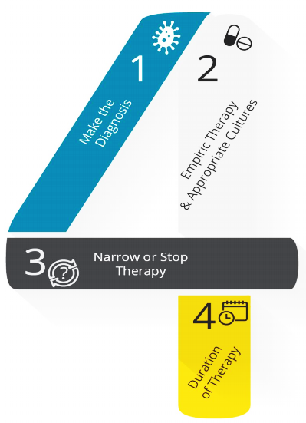
Optimization of Vancomycin (and All Antimicrobial) Use
Appropriate empiric use
Recognize the syndrome
Use syndrome-specific treatment
Consider individual patient factors
Send appropriate diagnostics
Follow guidelines to tailor treatment
AHRQ Safety Program for Improving Antibiotic Use 2018

Slide 36
Pneumonia – Recognize the Syndrome
Clinical manifestations
Tachypnea
Cough
Increased secretions
Hypoxia/increased O2 requirement
Crackles on exam
Radiographic findings may be misleading
Positive cultures may indicate colonization
Look-alikes: mucous plug, fluid overload, aspiration
“You have to have pneumonia, to have pneumonia”
Notes:
May be absent, particularly early in the disease course
May be present in absence of pneumonia

Slide 37
Additional Infectious Syndromes
May Require Empiric Gram-Positive Coverage
Do Not Require Empiric Gram-Positive Coverage
Sepsis
Skin and soft tissue infection
Meningitis
Febrile neutropenia
Urinary tract infection
Intra-abdominal infection
Notes:
Enterococcus even if susceptible does not need empiric coverage

Slide 38
Optimization of Vancomycin (and All Antimicrobial) Use
Appropriate empiric use
Recognize the syndrome
Use syndrome-specific treatment
Consider individual patient factors
Send appropriate diagnostics
Follow guidelines to tailor treatment
AHRQ Safety Program for Improving Antibiotic Use 2018

Slide 39

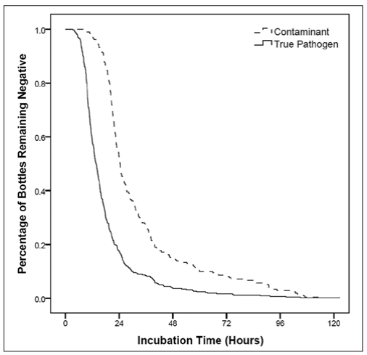
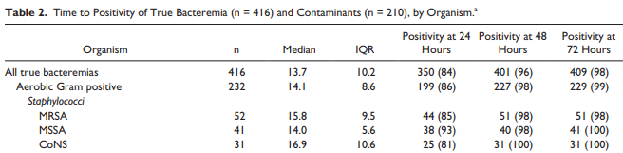
MRSA Diagnostic Methods
Nares screen
Culture
PCR
Blood
Culture
Molecular methods
“S. aureus is not a bashful pathogen” - JJ
Pardo Ann Pharmacother 2014
Notes:
Table 2. Time to Positivity of True Bacteremia (n = 416) and Contaminants (n = 210), by Organism
Culture – abundant growth in 18-24 hours
MRSA doesn’t hide
If you do find MRSA, that’s probably the answer

Slide 40
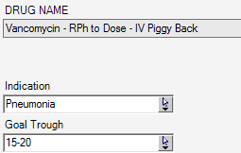
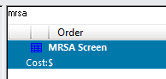
Pharmacy-Driven MRSA PCR Screen Protocol
PCR screen has high NPV for CAP and HAP
Order to be placed automatically for RPh vancomycin with indication “pneumonia”
Piloted at two UH sites
Not yet available at CMC
+
PCR
PCR
(To be added)
Notes:
lower for VAP

Slide 41
Optimization of Vancomycin (and All Antimicrobial) Use
Appropriate empiric use
Recognize the syndrome
Use syndrome-specific treatment
Consider individual patient factors
Send appropriate diagnostics
Follow guidelines to tailor treatment
AHRQ Safety Program for Improving Antibiotic Use 2018

Slide 42
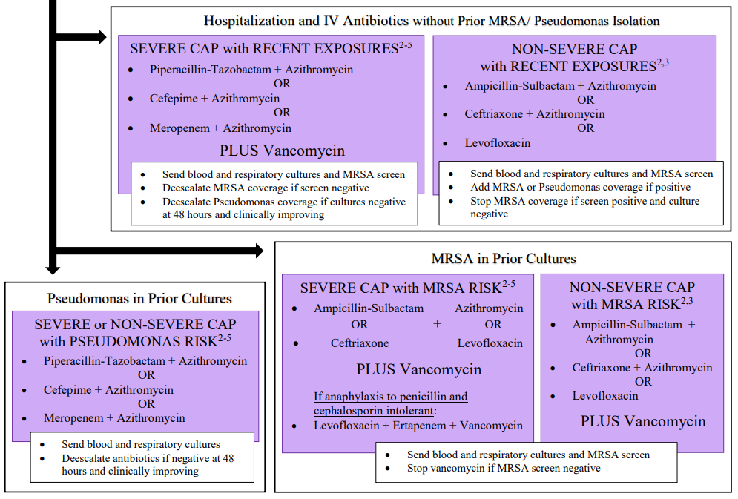
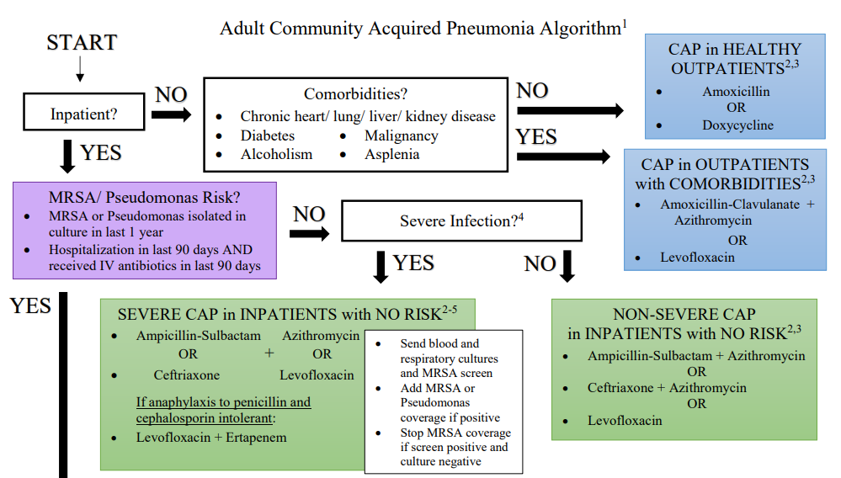

Slide 43
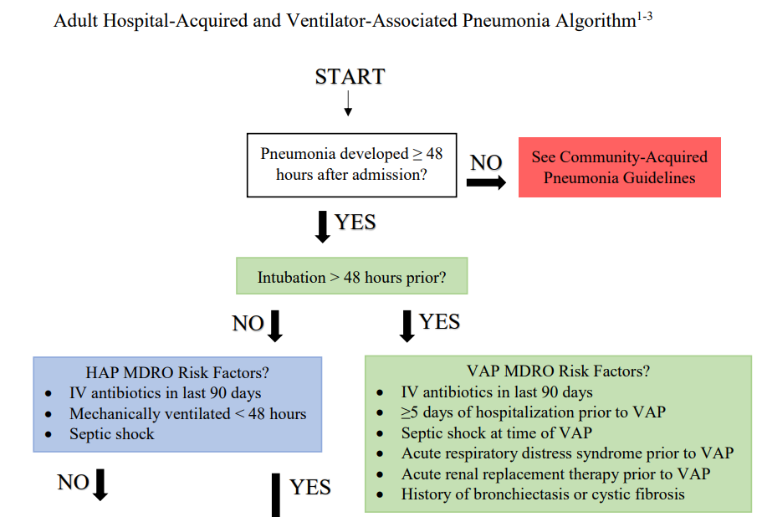
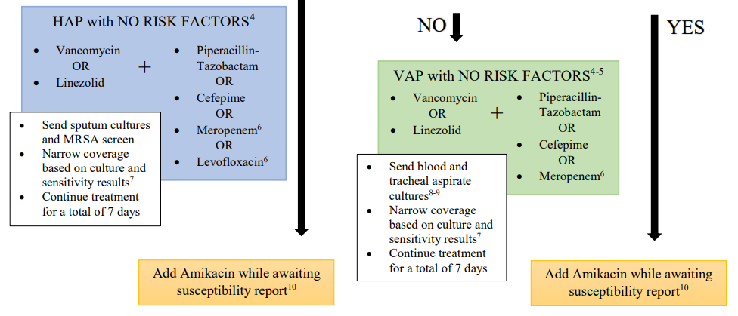

Slide 44

CAP versus HAP/VAP
CAP – Anti-MRSA coverage only indicated for:
Prior isolation of MRSA, or
Both hospitalization and receipt of IV antibiotics in the last 90 days
HAP/VAP – Everyone gets MRSA coverage
There is no HCAP!

Slide 45
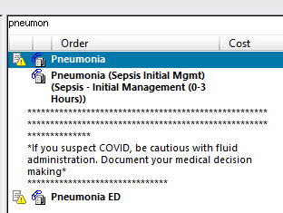
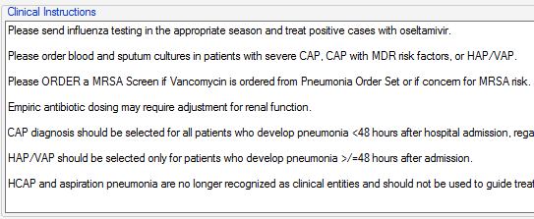
Inpatient Pneumonia Order Set

Slide 46



Slide 47


Slide 48


Slide 49


Slide 50


Slide 51


Slide 52




Slide 53


Slide 54


Slide 55



Patients with penicillin allergy without severe delayed reaction can receive carbapenems or non-cross-reacting cephalosporins

Slide 56
Reported Penicillin Allergy
~10% of the US population has a reported penicillin allergy
Vast majority of patients with reported allergy will be able to tolerate
Adverse reactions account for 30-75%
Childhood reactions often related to formulation
Reactions wane over time
Penicillins: 80% negative after 10 years
Cephalosporins: 60% negative after 5 years
Macy Perm J 2009, Park Mayo Clin Proc 2005, Gadde JAMA 1993
Notes:
Can be close to 25% in hospitalized patients requiring antibiotics

Slide 57

How about some ASP goodies to supplement your Jedi training?
You want the impossible

Slide 58








Handbook | Website | App

Slide 59
Case 1 Conclusion
Han was taken to the OR for open drainage of right hip and L thigh
Blood cultures remained positive for 72 hours prior to clearing
TTE negative, no other sources identified
Patient was later discharged by request to a SNF somewhere in the Outer Rim and completed a 6 week course of vancomycin

Slide 60

Case 2 Conclusion
The senior resident noted Ben’s lack of risk factors for resistant pathogens
Vancomycin and piperacillin-tazobactam were discontinued
Ceftriaxone was added to azithromycin
MRSA screen and respiratory cultures were added, later came back negative
After 5 days of treatment, he was back to room air
Mysteriously was able to convince the team not to send him back to his SNF…

Slide 61
Case 3 Conclusion
ID switched Leia’s antibiotics to daptomycin monotherapy at 8 mg/kg
E. faecium susceptibilities later revealed resistance to vancomycin and ampicillin
Planned for minimum 6-week course of treatment, but discussed possibility of AKA in the future
Her droids took her to stay with her daughter-in-law in Jakku

Slide 62

Case 4
ID stewardship called Sheev’s team to remind them that AMS in an elderly patient is not an indication for antibiotics, and that urine results likely represented asymptomatic bacteriuria
A former acquaintance of his daughter was eventually reached and provided collateral history that patient intermittently snorts kyber crystals
Patient subsequently went into cardiac arrest, and everyone agreed that DNR status was appropriate

Slide 63

Key Points
MRSA is a virulent pathogen, but is readily isolated
Vancomycin overuse leads to adverse events and resistance
Vancomycin use can be optimized by careful syndrome identification, appropriate diagnostics, and guidelines adherence
It is wise to make abundant use of your new ASP resources

Slide 64


Thank You!
Leila.Hojat@UHhospitals.org
LeilaSHojat

